Slide 1
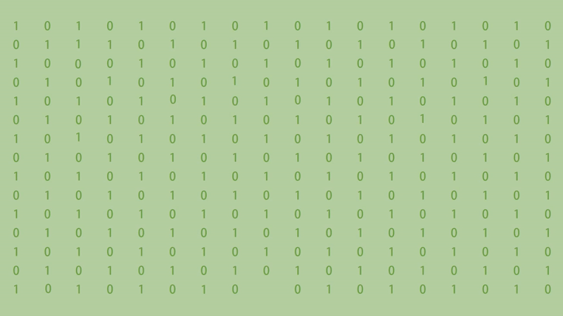
TEAM 3

Slide 2

1 | 0 | 1 | 0 | 1 | 0 |  | 0 |  | 0 | 1 | 0 | 1 | 0 | 1 | 0 | 1 | 0
0 | 1 |  | 1 | 0 |  | 0 | 1 | 0 | 1 | 0 | 1 |  |  | 0 | 1 |  | 1
1 | 0 |  | 0 | 1 | 0 | 1 | 0 | 1 |  | 1 | 0 | 1 | 0 | 1 | 0 | 1 | 0
0 | 1 | 0 |  | 0 | 1 | 0 |  | 0 | 1 | 0 | 1 | 0 | 1 | 0 |  | 0 | 1
1 | 0 | 1 | 0 | 1 |  | 1 | 0 | 1 |  | 1 | 0 | 1 | 0 | 1 | 0 | 1 | 0
0 | 1 | 0 | 1 | 0 | 1 | 0 | 1 | 0 | 1 | 0 | 1 | 0 |  | 0 | 1 | 0 | 1
1 | 0 |  | 0 | 1 | 0 | 1 | 0 | 1 | 0 | 1 | 0 | 1 | 0 | 1 | 0 | 1 | 0
0 | 1 | 0 | 1 | 0 | 1 | 0 | 1 | 0 | 1 | 0 | 1 | 0 | 1 | 0 | 1 | 0 | 1
1 | 0 | 1 | 0 | 1 | 0 | 1 | 0 | 1 | 0 | 1 | 0 | 1 | 0 | 1 | 0 | 1 | 0
0 | 1 | 0 | 1 | 0 | 1 | 0 | 1 | 0 | 1 | 0 | 1 | 0 | 1 | 0 | 1 | 0 | 1
1 | 0 | 1 | 0 | 1 | 0 | 1 | 0 | 1 | 0 | 1 | 0 | 1 | 0 | 1 | 0 | 1 | 0
0 | 1 | 0 | 1 | 0 | 1 | 0 | 1 | 0 | 1 | 0 | 1 | 0 | 1 | 0 | 1 | 0 | 1
1 | 0 | 1 | 0 | 1 | 0 | 1 | 0 | 1 | 0 | 1 | 0 | 1 | 0 | 1 | 0 | 1 | 0
0 | 1 | 0 | 1 | 0 | 1 | 0 | 1 | 0 | 1 | 0 | 1 | 0 | 1 | 0 | 1 | 0 | 1
1 |  | 1 | 0 | 1 | 0 |  | 0 |  | 0 | 1 | 0 | 1 | 0 | 1 | 0 | 1 | 0
1
1
1
1
0
1
0
0
0
1
1
1
0
0
1
1
0
0
0
1
0
1
1
0
1
1
1
1
0
0
1

Slide 3
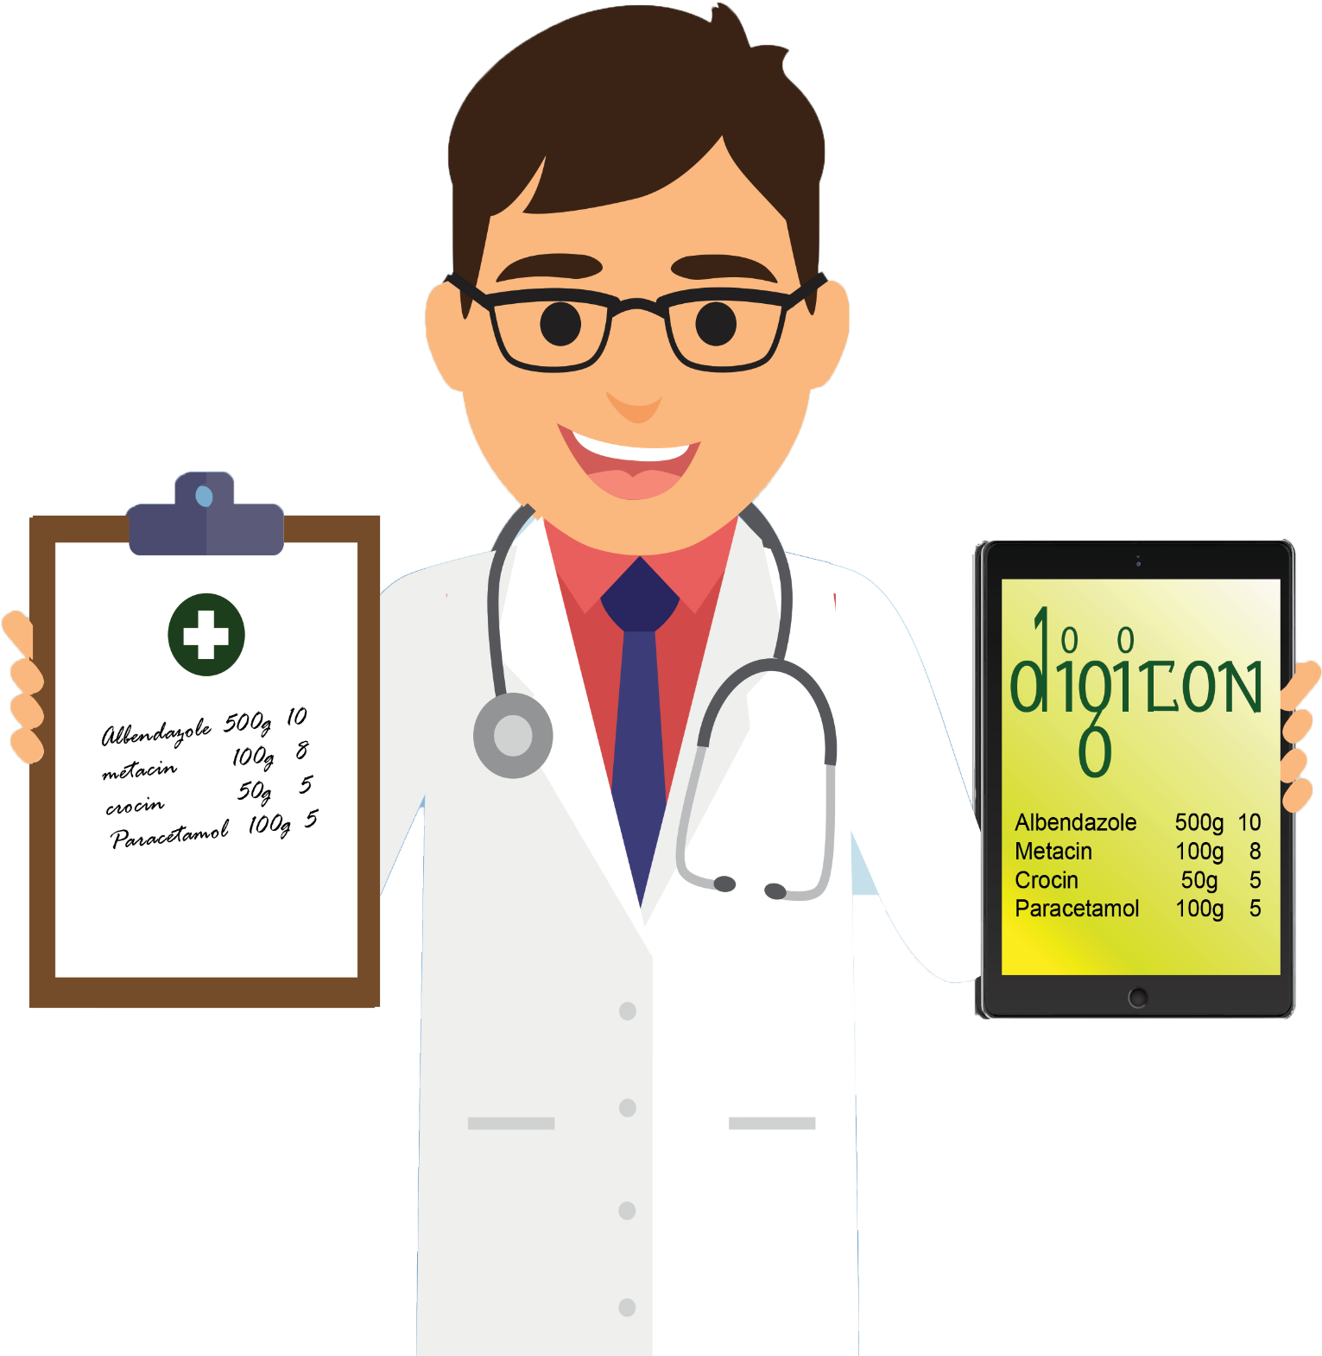
Enhancing
TEXT
Enriching
LIVES

Slide 4
Pre-Processing
Parsing Background Color
Isolating The Foreground
Color Palette Quantization
Contrast Enhancement

Slide 5
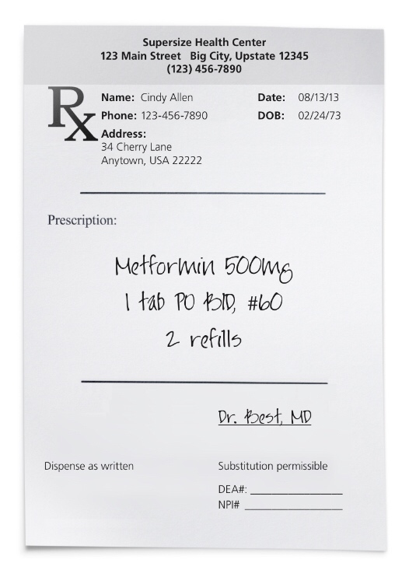
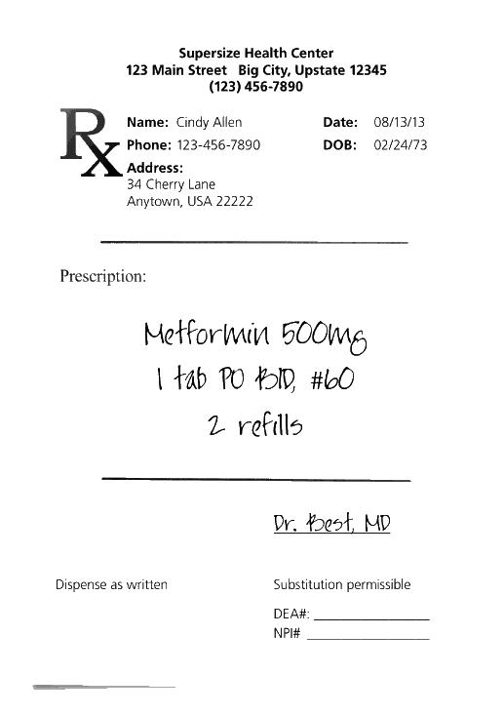
Pre-Processing
INPUT
OUTPUT

Slide 6
Intelligent Character Recognition
IT IS NOT POSSIBLE TO BEAT STATE OF THE ART
HEURISTICS

Slide 7
Intelligent Character Recognition
If Fails, AZURE Vision API
Use Google Cloud Vision API

Slide 8
Intelligent Character Recognition
Class Definition
class coordinate:
x = 0
y = 0
class boundingBox:
bound_text = ''
box_type = ''
tl = coordinate(0, 0)
tr = coordinate(0, 0)
br = coordinate(0, 0)
bl = coordinate(0, 0)
bb_children = []
lexi_type = ''
lexi_label = ''
dosage = {}
language = 'en'

Slide 9
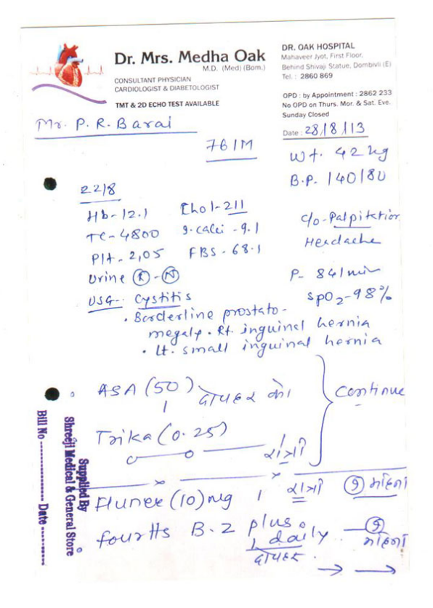
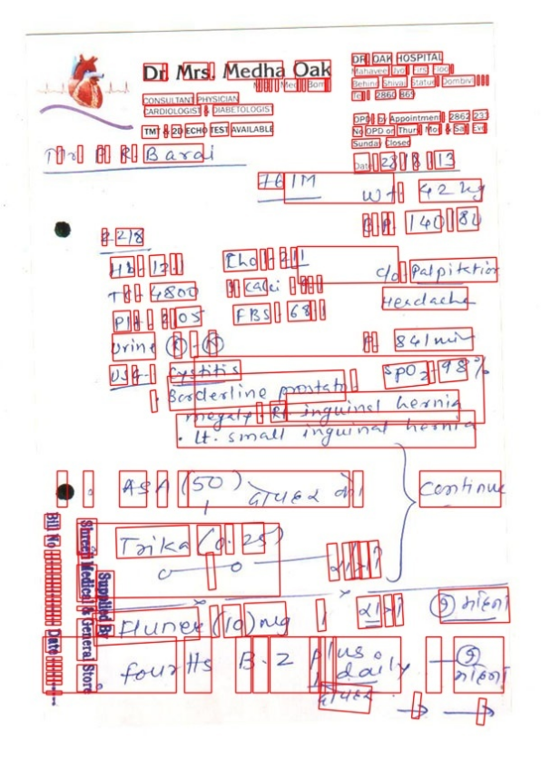
Intelligent Character Recognition
OCR

Slide 10
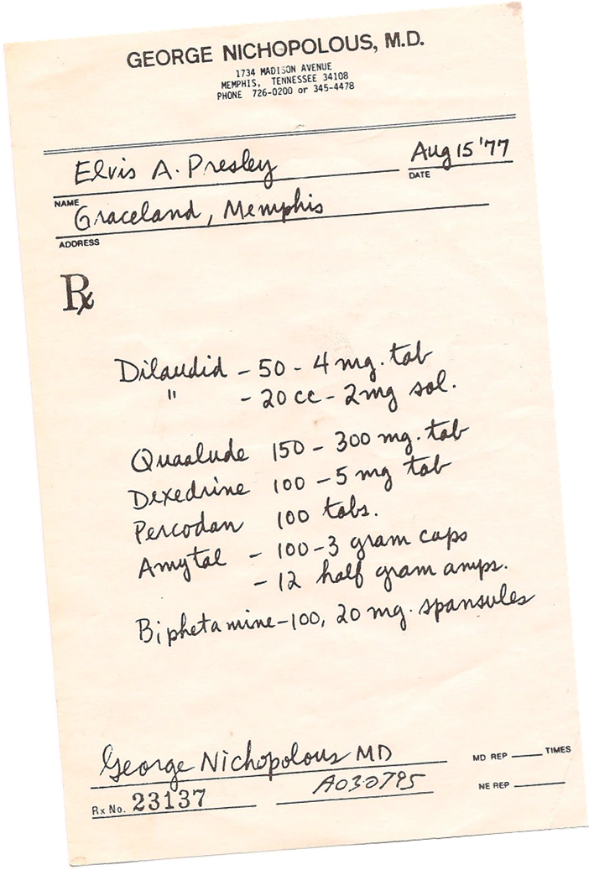
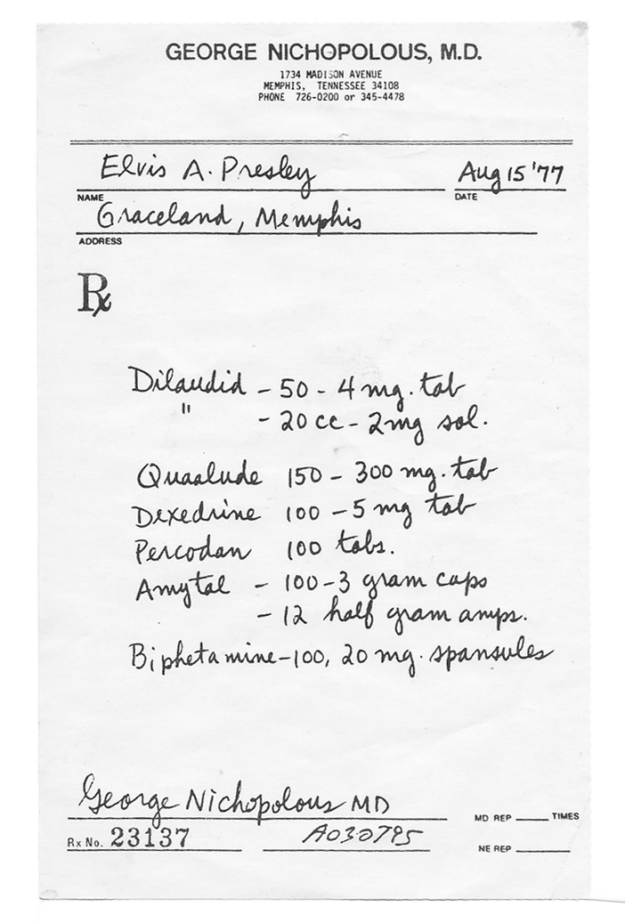
Orientation Detection
MINOR TILT

Slide 11
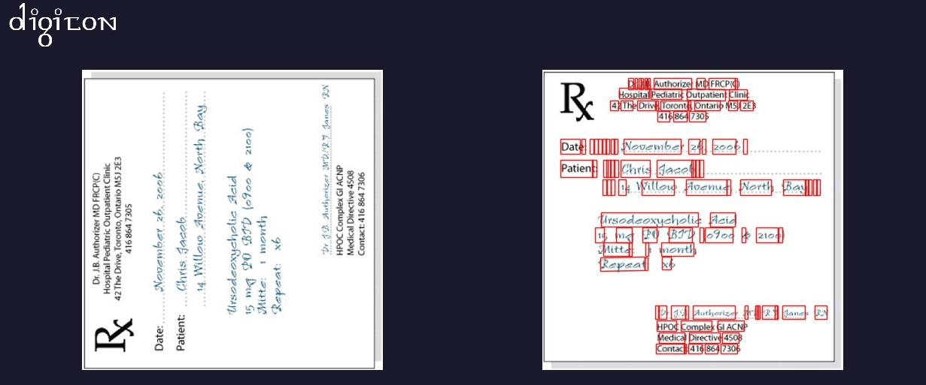
Orientation Detection
ROTATED BY RIGHT ANGLE

Slide 12
Spelling Correction
SENTENCE LEVEL
Original Sentence
Azure Spellcheck
Fix Bounding Boxes
OUTPUT

Slide 13
Spelling Correction
WORD LEVEL
English Dictionary
Medical Dictionary
Spell Checker
INPUT Word
OUTPUT Word

Slide 14
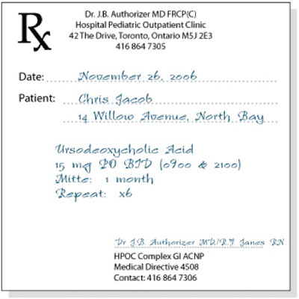
Metadata Extraction
CRUDE NER

Slide 15
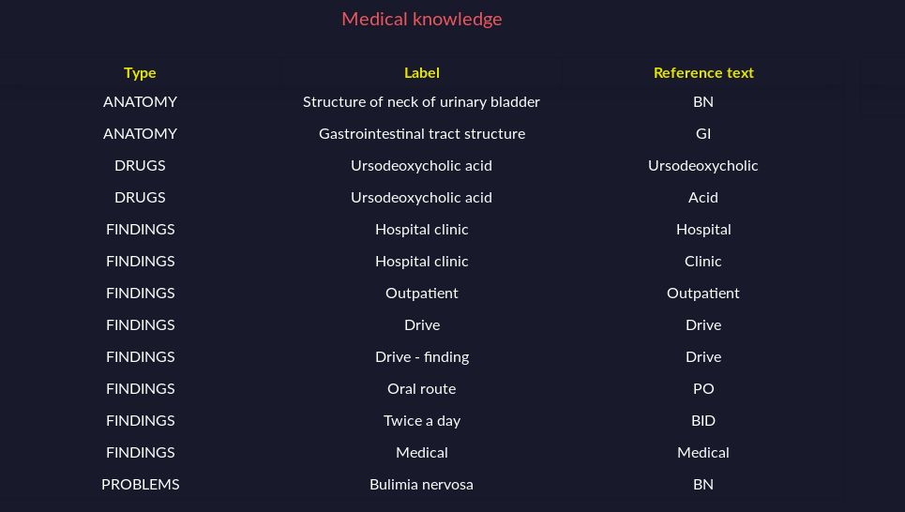
Metadata Extraction
MEDICAL DATA

Slide 16
Metadata Extraction
MEDICAL METADATA
Input Text
FINDINGS
Lexigram Medical Model
PROBLEMS
DRUGS
DEVICES
ANATOMY
DOSAGE

Slide 17

Metadata Extraction
DOSAGE EXTRACTION

Slide 18
Named Entity Extraction
INPUT
NER
Hospital
Address
Doctor
Specialization
Date
Phone No.
E-mail Address

Slide 19
Named Entity Extraction
SEARCH SPACE

Slide 20
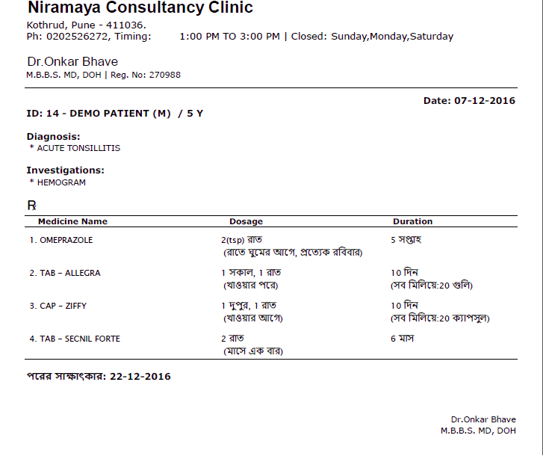
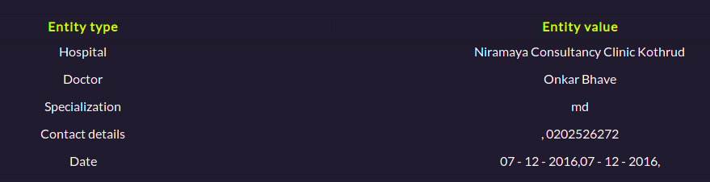
Named Entity Extraction
EXAMPLE

Slide 21
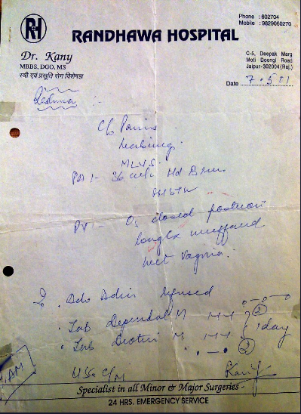
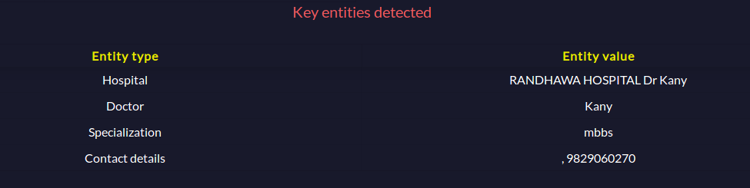
Named Entity Extraction
EXAMPLE

Slide 22
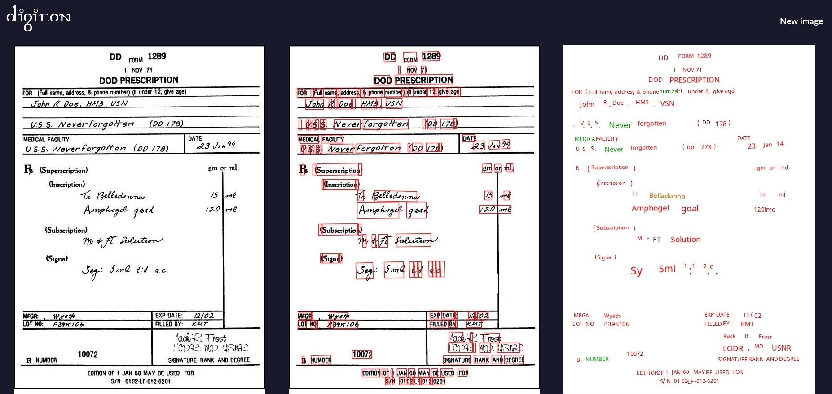
Generating Output
CLEAN

Slide 23
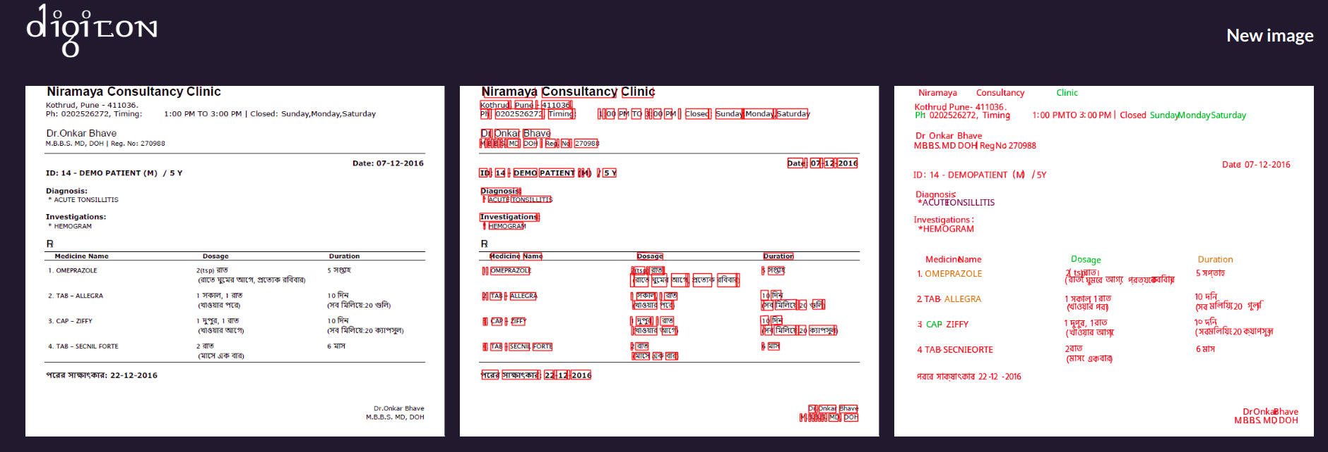
Generating Output
MULTIPLE LANGUAGE

Slide 24
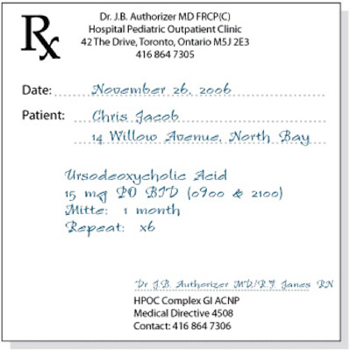
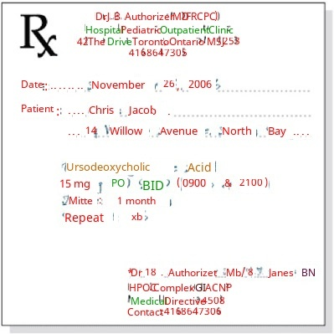
Generating Output
OVERLAY

Slide 25
Interface
Results arrive as soon as available
Real-time Status
Options to Downlaod as PDF/Image

Slide 26
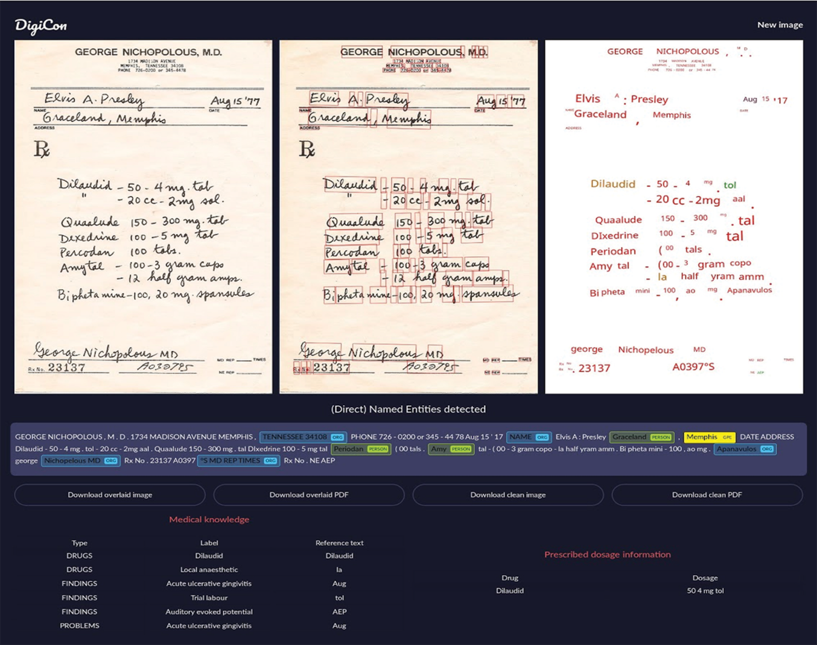
Interface

Slide 27
Interface

Slide 28


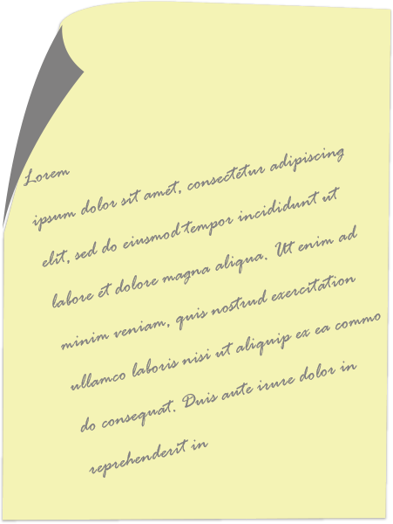


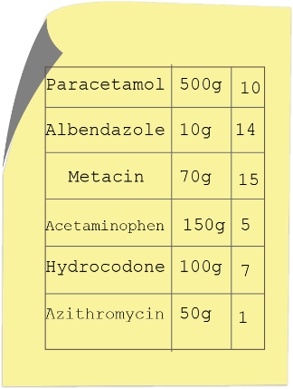


Pipeline
Fix Orientation
Draw Boundary Boxes
Character Level
Fix Spelling
Sentence Level
GOOGLE CLOUD
VISION API
OCR
PRE-PROCESSING
Crude NER
AZURE
VISION API
Extract Medical
Data
Create PDFs
Entity Extraction
Get Dosage Data
Corrected
Generate Digital Prescription
Fresh

Slide 29
Survey
State of the Art OCR Accuracy
DigiCon’s Accuracy
Average Entities Extracted
61.3%
82.1%
3.2

Slide 30
DEMO

Slide 31
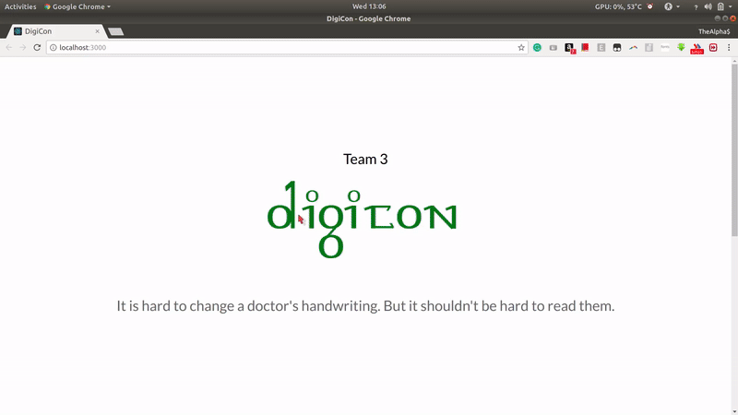

Slide 32
Questions

